Slide 1
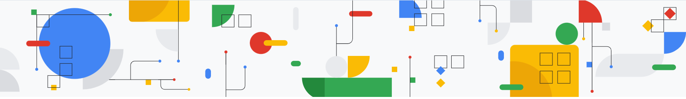
Fine tuning LLM
:- Harsh Dalal

Slide 2
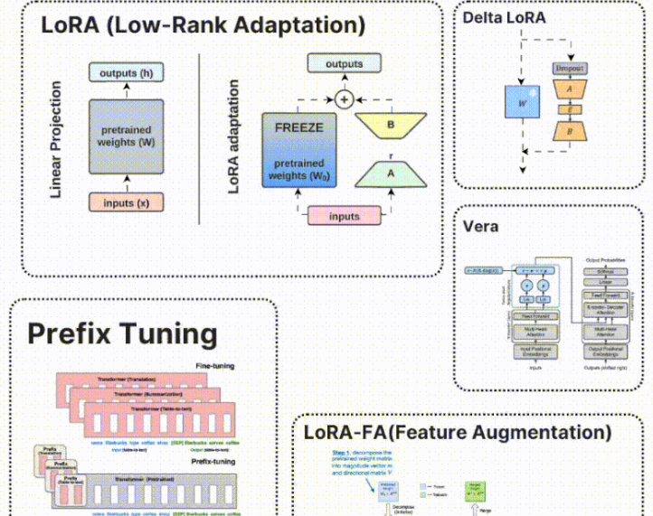
Fine tuning LLM
Techniques

Slide 3
What is Full Fine-Tuning?
Full fine-tuning involves updating all model parameters based on a new dataset and task. This is commonly used in adapting pre-trained models like GPT, BERT, and T5 to domain-specific applications.
Advantages
Maximum Task Adaptation: Fully adapts the model to new tasks without constraint.
No Architectural Modifications: Maintains the model’s original structure.
Better Performance on Large Datasets: Ideal when extensive labeled data is available.
Disadvantages
High Computational Cost: Requires significant GPU/TPU resources and storage.
Catastrophic Forgetting: May lose knowledge from pre-training.
Inefficient for Multi-Task Learning: Requires retraining for each new task.

Slide 4
What is PEFT
Parameter-Efficient Fine-Tuning (PEFT) optimizes adaptation by modifying a smaller set of parameters while keeping the majority of the model frozen. Common PEFT techniques include
LoRA (Low-Rank Adaptation) – Introduces trainable low-rank matrices.
IA3 (Infused Adapter-Attention) – Modifies activations using learned scaling factors.
Adapters – Introduces small task-specific layers between transformer layers.
Prefix Tuning – Optimizes continuous prompts instead of modifying weights.

Slide 5
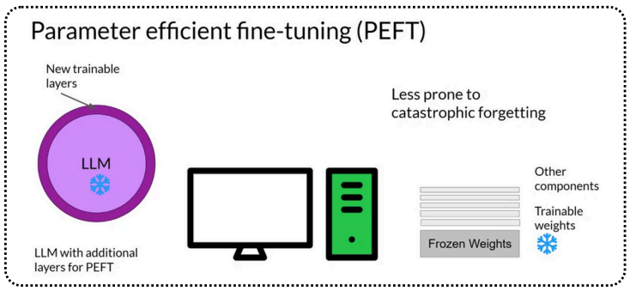
What is PEFT
Fine-tuning massive models like GPT and BERT can be computationally expensive and storage-intensive. PEFT methods tackle this challenge by introducing small, trainable parameters that modify specific layers of the model while keeping the majority of weights frozen. This dramatically reduces computational overhead and enables efficient adaptation to new tasks.

Slide 6
When to use PEFT?
Use PEFT If:
You have limited computational resources.
You need to fine-tune large models efficiently.
You are working on multi-task learning or transfer learning.
You want to retain knowledge from the pre-trained model while adapting to new tasks.

Slide 7
Key Features of PEFT
Reduces memory usage by keeping most model weights frozen
Faster training with fewer trainable parameters
Maintains performance close to full fine-tuning

Slide 8
LoRA
:- Harsh Dalal

Slide 9
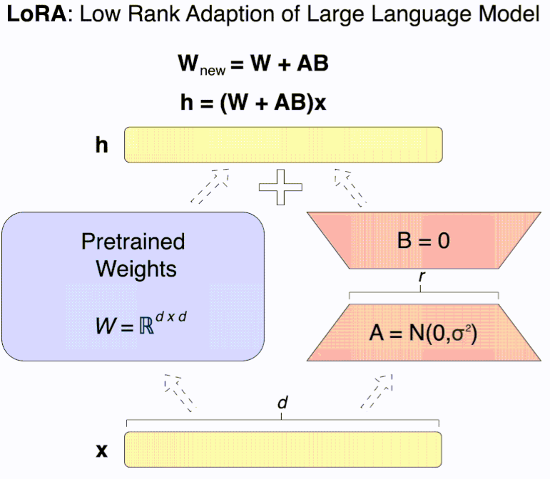
What is LoRA
LoRA (Low-Rank Adaptation) is a specific PEFT method that decomposes weight updates into low-rank matrices, reducing the number of trainable parameters.

Slide 10
How LoRA Works
Instead of modifying the original weights, LoRA injects low-rank trainable matrices into the pre-trained model’s layers (typically in attention layers of Transformers).
These matrices capture task-specific knowledge while keeping the base model unchanged, allowing for efficient adaptation.

Slide 11

Key Features of LoRA
Uses low-rank matrices to adapt pre-trained weights
Reduces GPU memory requirements significantly
Performs well across multiple tasks with minimal fine-tuning

Slide 12
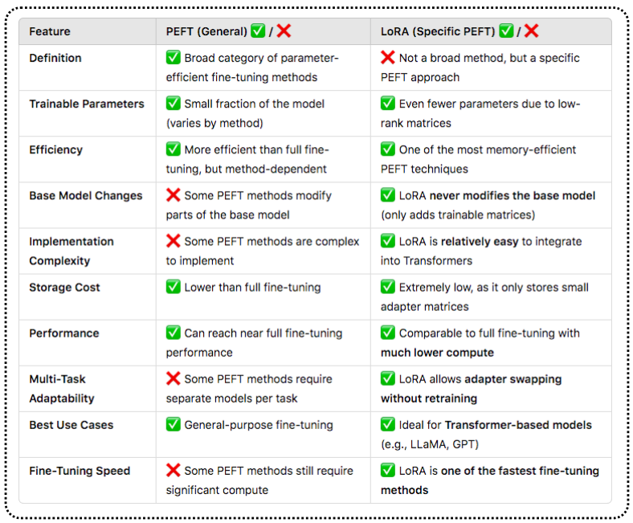
PEFT vs LoRA – Key Differences

Slide 13

When to Use PEFT vs LoRA?
Use PEFT
when You need a general framework for efficient fine-tuning
You want flexibility in choosing methods (prompt tuning, adapters, LoRA, etc.)
Your model has limited compute or memory for training
Use LoRA when
You are fine-tuning Transformer-based models efficiently
You need to fine-tune multiple tasks efficiently while keeping the base model unchanged
You want to deploy fine-tuned adapters without storing multiple full model copies

Slide 14

Any question

Slide 15

Thank you

